Slide 1

Week 2 Progress Report: Quantum-Enhanced Graph Optimization for Trustworthy Multi-Agent Coordination in Digital Twin Robotics
Student: Joseph Ko
Mentor: Yugyung Lee
June 9th, 2025

Slide 2

Problem Statement Overview
Real-time digital twins (DTS) mirror physical robots and environments for simulation and monitoring.
However, attacks such as sensor spoofing, message tampering, and desynchronization can compromise system safety and coordination.
Goal: Build a quantum-enhanced, trust-aware AI framework for detecting and responding to such attacks.
I learned that trust modeling must be dynamic and responsive—part of the control loop, not just a monitoring layer.

Slide 3
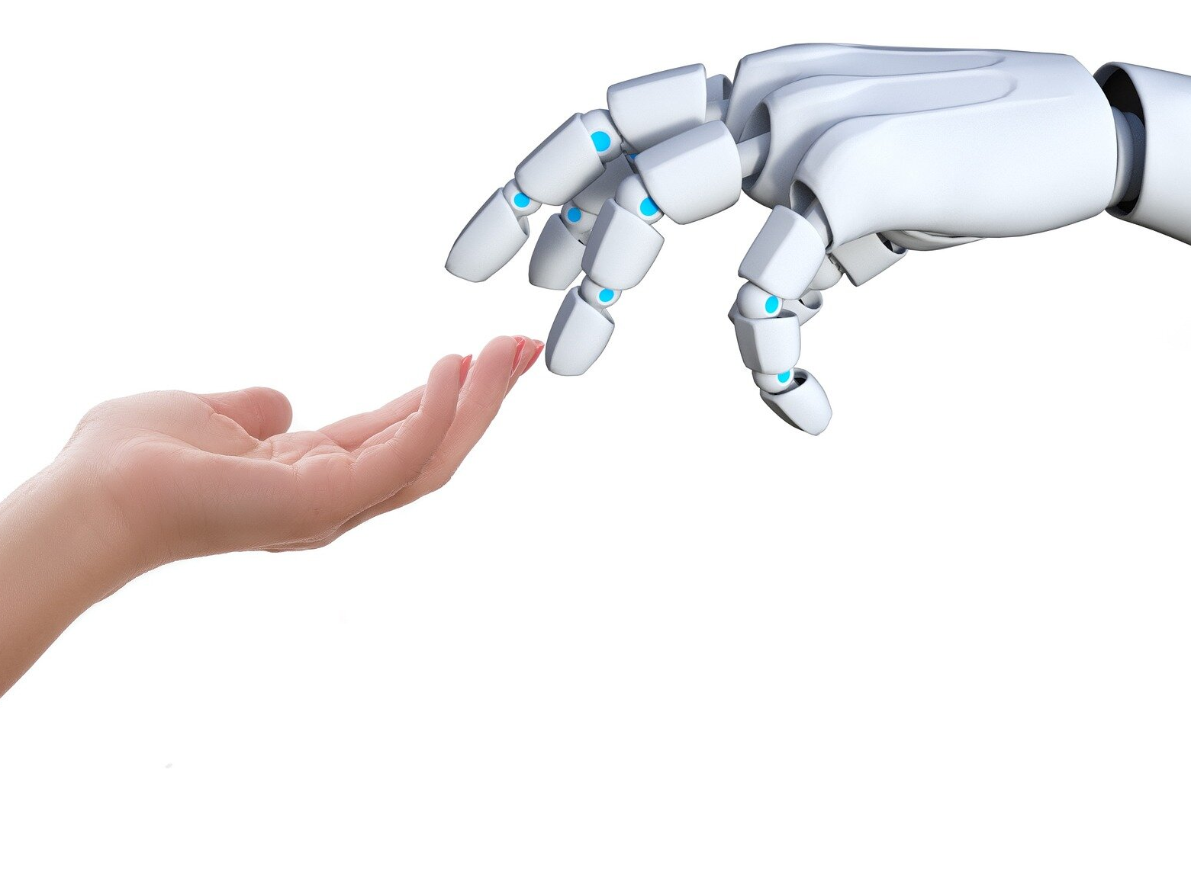
Related Work & Key Insights
ECT Model (Obi et al. 2025): Trust evolves by comparing agent performance vs. expectations
- I can use ECT to maintain adaptive trust scores for each robot in the twin—helping to decide when a robot should or should not be assigned critical tasks.
TIP Model (Guo et al. 2023): Trust combines direct experiences with indirect observations of others
- I can use TIP to propagate trust updates through the team graph, so trust of a compromised robot spreads realistically to human operators and teammates.
PitM Attacks (Carr et al. 2022): Shows ROS-based twins can be compromised; attacks on velocity or joint commands can cause physical harm.
- I can try and test similar attack patterns to simulate adversarial conditions and test whether my trust + anomaly system detects them.
techxplore, 2024

Slide 4

AI Methods and Plans for Setup
AI Methods:
- Quantum Approximate Optimization Algorithm (QAOA) for trust-aware task allocation: Robots with higher trust should get critical or sensitive tasks.
- Use TIP + ECT trust updates embedded in a live knowledge graph (robots, tasks, sensors, humans).
- Graph-based anomaly detection for spotting subtle attack signatures.
Initial Setup:
- Use ROS/Gazebo/other simulation with 2H–2R digital twin testbed.
- Define initial PitM attack scenarios (velocity and joint manipulation).
Learning: Trust must directly influence which agents are trusted to take on which tasks, especially under attack.
CEPS, 2024

Slide 5

Next Steps, Challenges, Reflections
Next Steps:
Guidance on the use of resources, project collaboration, and learning with mentors and other students
Updates with mentor and mentee group
Hope to:
- Implement TIP and ECT trust updates in a graph structure.
- Integrate QAOA-based task allocation (or a different Quantum AI source) with real-time trust scoring.
- Run controlled attack simulations (e.g., PitM) and analyze trust and anomaly responses.
Current Challenges:
- Getting the correct materials and equipment
- Gaining a solid grasp of key concepts and skills needed for the project
Reflection:
- I now see that trust modeling is not an add-on—it must drive the entire coordination logic if the system is to remain safe and efficient under adversarial conditions.
Startups Magazine, 2019

Slide 6
References
Carr, Christopher, et al. Attacking Digital Twins of Robotic Systems to Compromise Security and Safety. arXiv, 17 Nov. 2022, https://arxiv.org/pdf/2211.09507.
Guo, Yaohui, X. Jessie Yang, and Cong Shi. TIP: A Trust Inference and Propagation Model in Multi-Human Multi-Robot Teams. arXiv, 26 Jan. 2023, https://arxiv.org/pdf/2301.10928.
Obi, Ike, et al. Modeling and Evaluating Trust Dynamics in Multi-Human Multi-Robot Task Allocation. arXiv, 16 Sept. 2024, https://arxiv.org/pdf/2409.16009.

